Slide 1
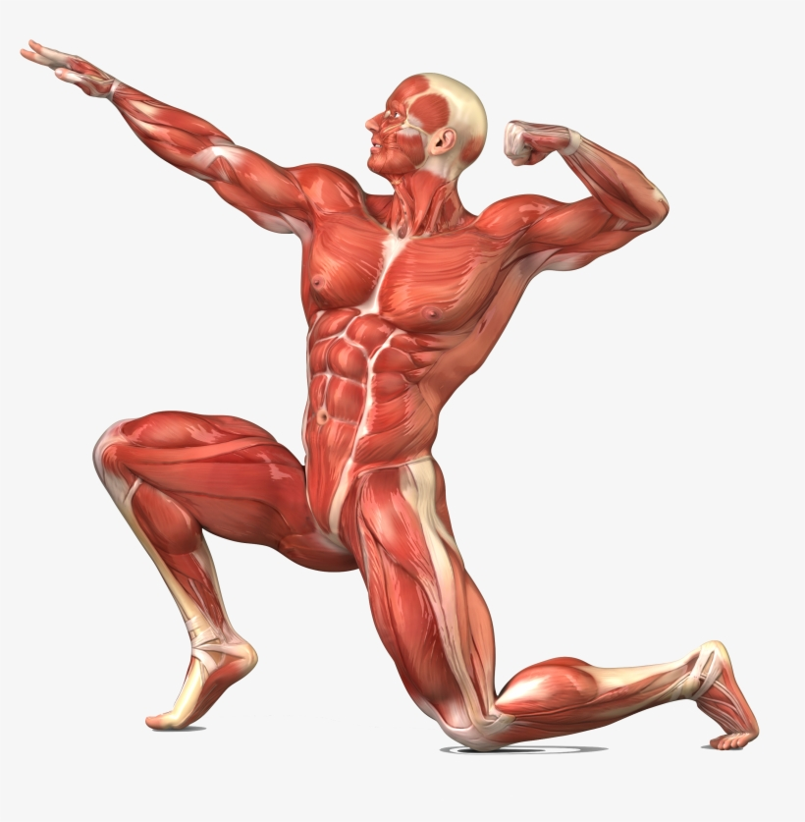
Year 3 Autumn What does our body do for us?

Slide 2
Year 3 Autumn – What does our body do for us? Intent: The Why Behind our Topic
Rationale
‘What does our body do for us?’ will give children an in-depth insight into The human body and how it works. The topic will give children the opportunity to develop their speech and language skills and vocabulary related to Science with a particular focus on the human body. The topic will focus on developing an understanding of why we eat by delving into the digestive system, why we need to eat to survive by investigating the nutritional value of food and how we hear by exploring the structure of the ear and how sound is made. Key Curriculum Areas: Science, History, Geography, Art, DT, PSHE. We will meet the S&L needs of our children by: developing their use of language related to Science. Providing opportunities for children to investigate how the body works and present back to the class using key topic vocabulary. We will allow children to understand cultural differences and break down stereotypes by: Recognising how peoples bodies are different in size, shape, ethnicity dependent on where they are in the world and why this might be. We will meet the SEMH needs of our children by: Discussing and promoting acceptance towards people of different backgrounds, cultures and religions and understanding that we all have similarities and differences in our bodies. We will meet the socio-economic disadvantages of our children by: Promoting healthy eating and exploring how to ensure we are eating a balanced diet. We will also promote teeth health by investigating the importance of brushing our teeth.
Purposeful Outcome: Most children will be able to label the different types of teeth, parts of the digestive system and parts of the ear explaining some of the simple functions of each. Some children will be able to explain the path food takes through the body as it is digested and describe the role each part of the digestive system takes in this.

Slide 3
Year 3 Autumn – What does our body do for us? Intent: Topic-developed NCS Requirements
Subject | NCS Requirements
Science Art DT History & TBC | identify that animals, including humans, need the right types and amount of nutrition, and that they cannot make their own food; they get nutrition from what they eat identify that humans and some other animals have skeletons and muscles for support, protection and movement. describe the simple functions of the basic parts of the digestive system in humans identify the different types of teeth in humans and their simple functions identify how sounds are made, associating some of them with something vibrating and recognise that vibrations from sounds travel through a medium to the ear find patterns between the pitch of a sound and features of the object that produced it and find patterns between the volume of a sound and the strength of the vibrations that produced it recognise that sounds get fainter as the distance from the sound source increases. to improve their mastery of art and design techniques, including drawing, painting and sculpture with a range of materials [for example, pencil, charcoal, paint, clay] understand and apply the principles of a healthy and varied diet Design, make and evaluate a product that is fit for purpose – an instrument that makes three different sounds. Look at significant historial scientists in the discovery of how the Human body works – Ivan Pavlov.
Writing | Talk for Writing Units:

Slide 4
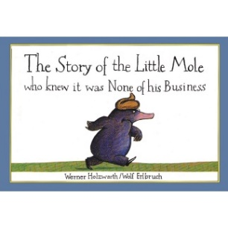
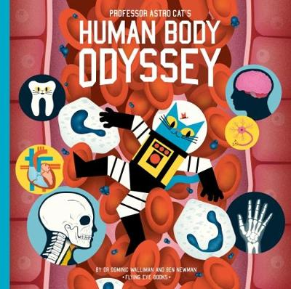
Year 3 Autumn – What does our body do for us? Implement: Topic-developed NCS Requirements
 | Term Skeleton Coverage
Week 1: Week 2: Week 3: Experience: | The key curriculum objectives will be met through: Science: Children will learn about the different types of teeth they have as humans (and how these differ to the teeth of other animals), and what happens to food at each stage of the digestive system from the teeth through to the throat, intestines and rectum. Children will conduct an experiment to follow the route of food through the body and to see the effects that food and drink can have on our teeth if we don’t take care of them. Children will also explore the role of food in keeping our bodies healthy by looking at the nutritional value of different foods. Topic Week 2 – Art & DT: Children will create a human body art attack in the classroom in large groups to show the skeleton, muscles and the digestive system. They will label the different parts of their artwork. Children will also design, make, test and evaluate a musical instrument that must make three different sounds. They will use this to explore the relationship between vibrations and hearing. Children will also design and make a healthy meal preparing food and learning about safety in the kitchen. History & Geography : Explore discoveries of how the human body works by Scientists from history in particular Ivan Pavlov. Identify why people’s bodies may be different depending on where they live in the world especially in relation to different diets and living conditions. Visit to the Science Museum in Bradford
Reading and Writing | Class Books – The little mole who knew it was none of his business. Professor Astro Cat’s human body odyssey (non fiction). Shared Reading – Extracts from: Professor Astro Cat’s human body odyssey and the little mole who knew it was none of his business. Talk for Writing Units: To be decided by the class teacher

Slide 5
Year 3 Autumn – What does our body do for us? Implement: Topic-developed NCS Requirements
 | Medium Term Plan
Week 1: Week 2: Week 3: | The key curriculum objectives will be met through: Science: Lesson 1: Children to address missconceptions, what do they already know. Look at teeth, Names of teeth, their purpose – comparing to other animals. Lesson 2: deeper look into the digestive system what happens at each stage of the process. Lesson 3: Healthy eating, balanced plate, workshop on healthy eating creating a healthy dish Lesson 4: sound, how do our ears help us to hear. What are the different parts of the ear. Lesson 5: Our skeleton. What is the purpose of it? How does it help us? What are the muscles. Art & DT: .Trip to a museum of medicine. To investigate Picasso Create a self portrait of themselves In the style of Picasso. TBC:
Experience: | Healthy eating workshop (visit from chef) Trip to a museum – Thackeray Museum

Slide 6
Year 3 Autumn – What does our body do for us? Impact: Subject Leader and Teacher Evaluation
How did society change in the Stone Age?
Teacher General Review of Topic: The Children loved this topic. However some of the vocab and terminology was lost on the children and this could really be worked on, possible further understanding is needed. Subject Specific Review of Topic: History: Children gained some understanding of the period and how long ago it was. Geography: Children understood where key monuments were such as Stonehenge. Science: Art: DT:
Curriculum Coverage – Assessment Evaluation History: Geography: Science: Art: DT:

